Slide 1
Shot Classification

Slide 2

Visual Language
Cinema is about how ideas and emotions are expressed through visual form
Most Basic Element is a shot

Slide 3
The Dataset
Hand-Labeled through domain knowledge
Classes:
Extreme Wide Shot
Long Shot
Medium Shot
Medium Close Up
Close Up
Extreme Close Up

Slide 4
Shot Types

Slide 5
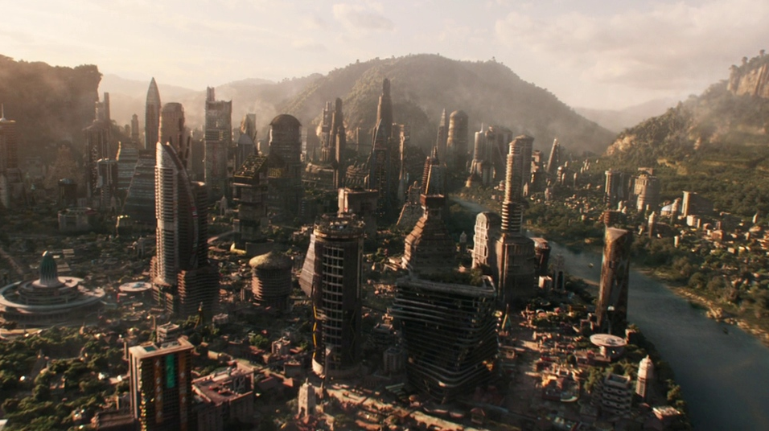
Extreme Wide Shot

Slide 6
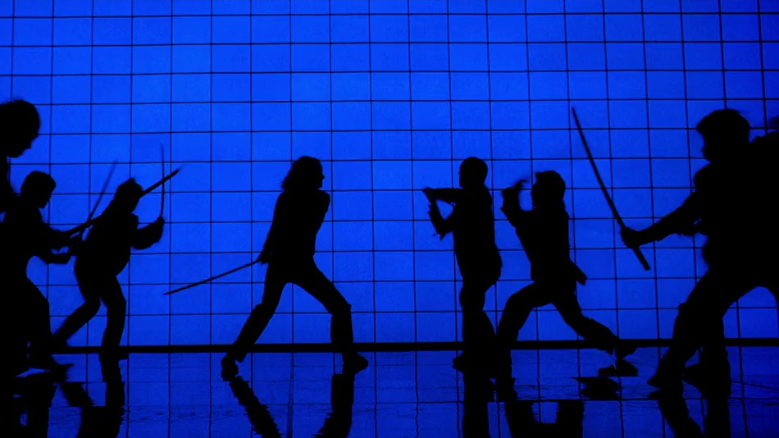
Long Shot

Slide 7
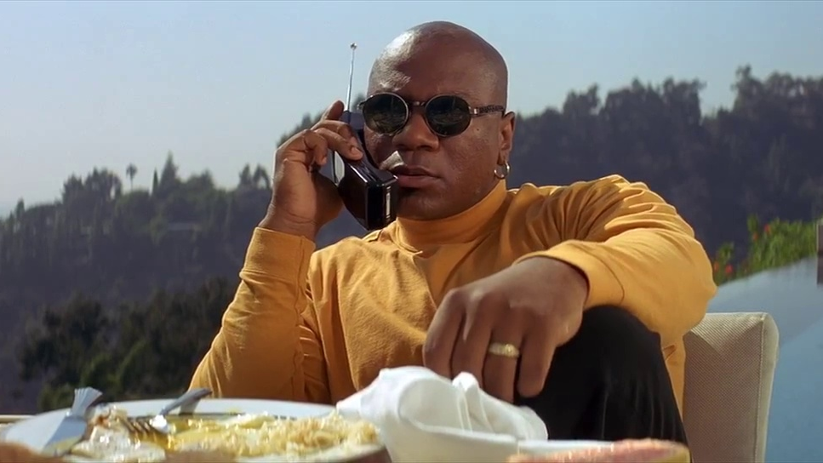
Medium Shot

Slide 8

Medium Close Up

Slide 9
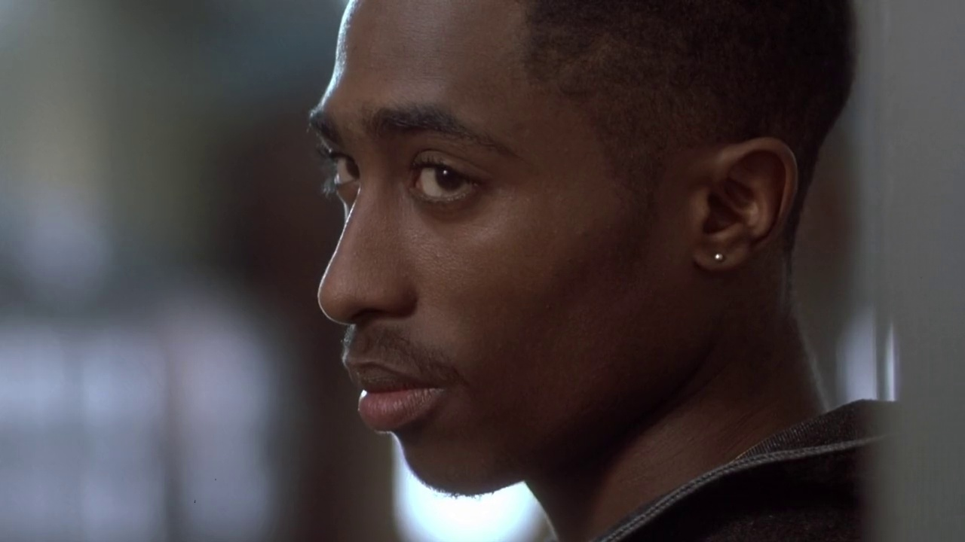
Close Up

Slide 10
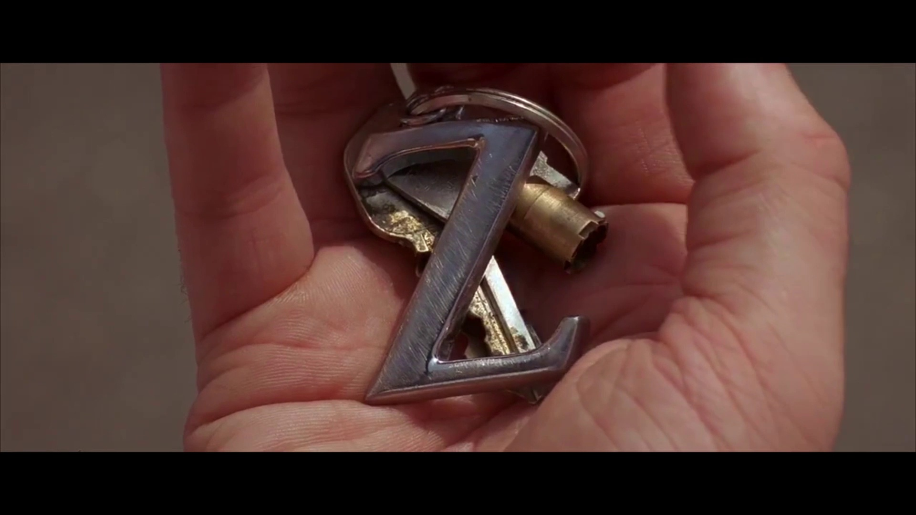
Extreme Close Up

Slide 11
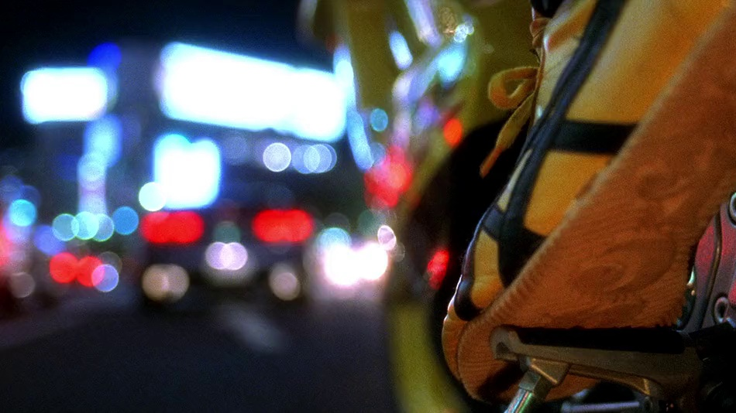
Shot Type?

Slide 12
Methodology
Pretrained ResNet-50(ImageNet)
Pretrained VGG19
Custom CNN

Slide 13
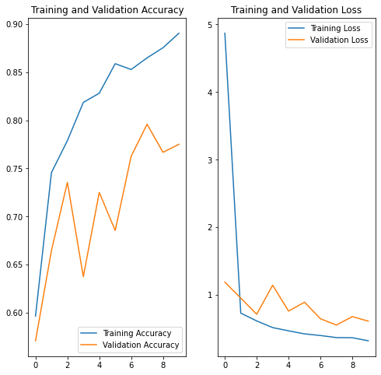
Results

Slide 14
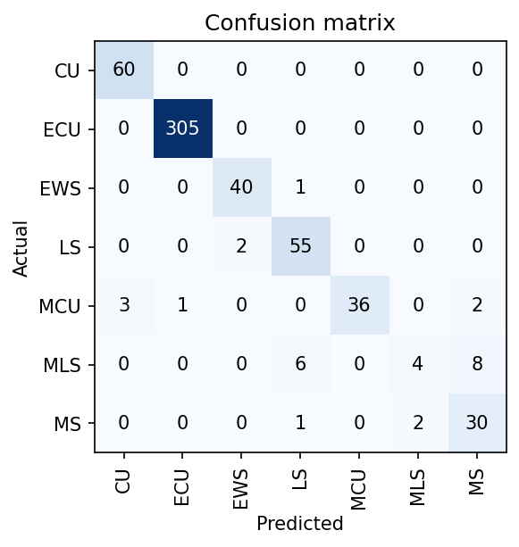
Confusion Matrix

Slide 15
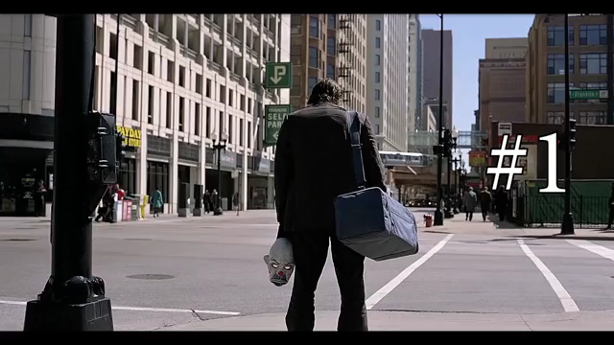
Putting It all Together
# | Length | Type | Camera Angle | Camera Movement
1 | 10.42 | LS,MS | Eye Level | Zoom
2 | 2.25 | LS | Hip Level | Static
3 | 0.71 | MCU | Low Angle | Static
4 | 3.10 | LS,MS | Eye Level | Tracking,Tilt
5 | 4.12 | EWS | High Angle | Drone, Pan
6 | 1.30 | LS | Low Angle | Static

Slide 16
What Else Can Be done?
Color Analysis
Adding more images
Audio Analysis
Motion Tracking

Slide 17
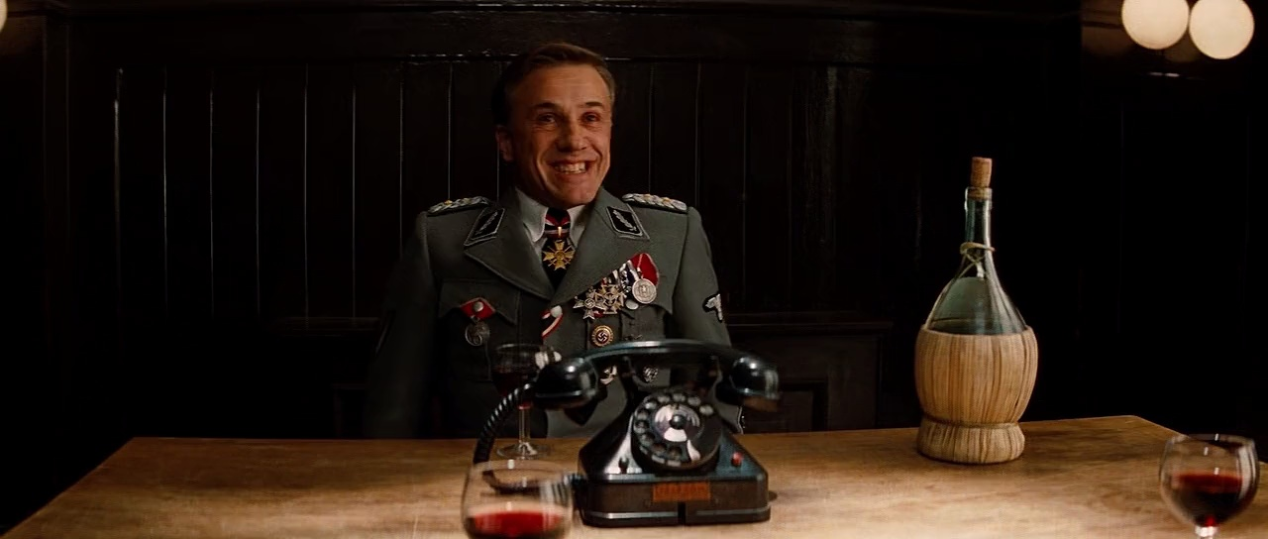
Any Questions?

